Slide 1


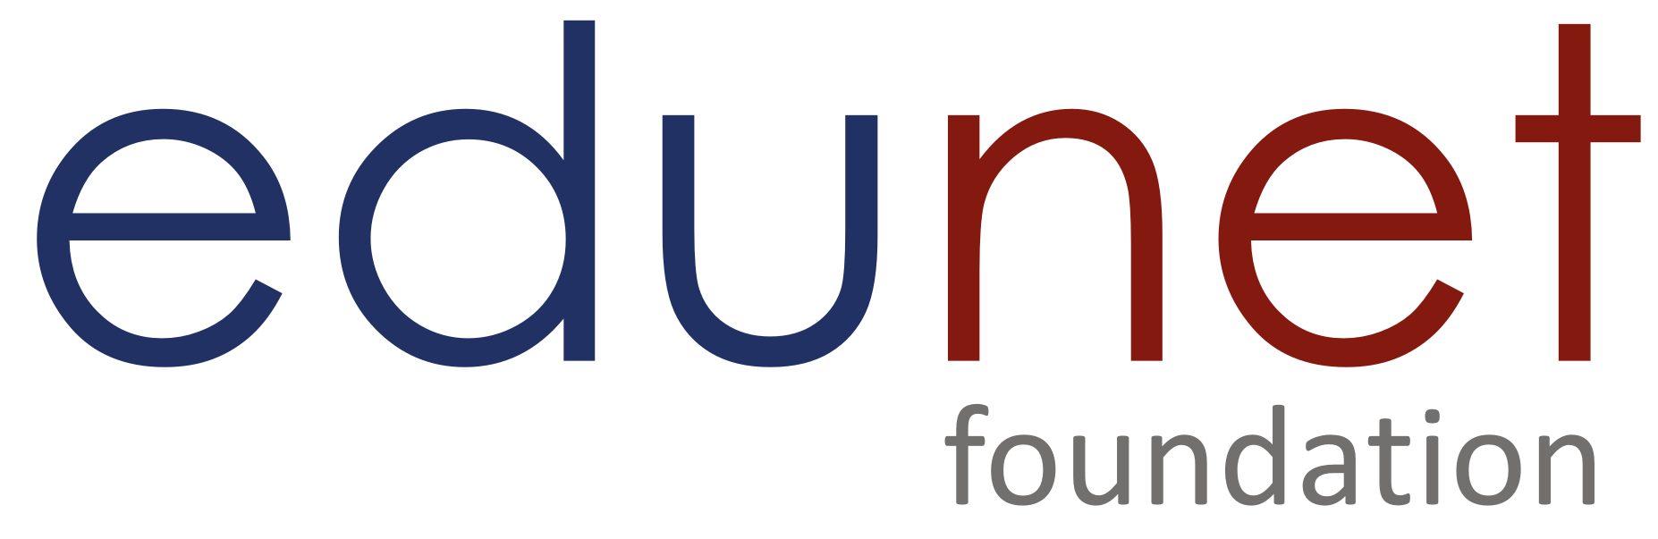

NEXT GEN EMPLOYABILITY PROGRAM
Creating a future-ready workforce
Team Members
College Name
Student Name :CHARULATHA R
Student ID :au814721104013
SRM TRP Engineering College

Slide 2

CAPSTONE PROJECT SHOWCASE
Project Title
Notes Sharing Web Application using Django Framework
Abstract | Problem Statement | Project Overview | Proposed Solution | Technology Used | Modelling & Results | Conclusion

Slide 3
Abstract
Chals Edu Academy epitomizes a sophisticated web application engineered on the Django framework, meticulously crafted to streamline note sharing and collaboration among users. Leveraging Django's robust architecture, the platform implements advanced user authentication and authorization protocols, ensuring stringent data security and privacy. Users can seamlessly create, organize, and share notes through an intuitive interface, enriched with various formatting options for personalized content creation.
Key technical features include real-time collaboration functionality, enabling concurrent editing and viewing of notes by multiple users. Granular access controls empower users to fine-tune permissions, dictating who can view, edit, or share notes. Additionally, Chals Edu Academy boasts version control capabilities, maintaining a detailed history of note revisions for seamless tracking and rollback. The application's responsive design ensures optimal performance across diverse devices, enhancing accessibility and user experience. Chals Edu Academy represents a pinnacle in note sharing and collaboration platforms, combining Django's robustness with intuitive design to redefine digital teamwork paradigms.
Source :

Slide 4
Problem Statement
Despite the abundance of note-sharing platforms, a critical void exists in the market for a technically advanced solution tailored to the unique collaboration and security needs of educational environments. With the introduction of Chals Edu Academy, our mission is to bridge this gap by developing a Notes Sharing Web Application using the Django Framework. Chals Edu Academy aims to revolutionize the landscape by providing a robust platform equipped with cutting-edge features such as real-time collaboration, version control, and access management. By harnessing the power of Django, we endeavor to create a scalable and secure solution that enhances productivity and fosters seamless collaboration among students, educators, and professionals within the educational sphere.
Source :

Slide 5
Project Overview
The Notes Sharing Web Application project, known as Chals Edu Academy, utilizes the Django Framework to facilitate seamless collaboration and note-sharing. Its key features include robust user authentication, real-time collaboration, version control, access management, and responsive design. The project aims to develop a scalable and secure platform that enhances productivity and fosters collaboration among users in educational and professional contexts.
Project Goals:
Develop a scalable and secure Notes Sharing Web Application using the Django Framework.
Implement advanced features such as real-time collaboration and version control to enhance user experience and productivity.
Ensure data security and privacy through robust authentication and authorization mechanisms.
Provide a user-friendly interface for seamless note creation, organization, and sharing.
Foster collaboration and knowledge sharing among users within educational and professional settings.
By achieving these goals, Chals Edu Academy aims to set a new standard for note-sharing platforms, empowering users to streamline their collaboration processes and enhance productivity in their academic and professional endeavors.
Source :

Slide 6
Proposed Solution
.
The proposed solution entails the development of a robust and feature-rich Notes Sharing Web Application, christened as Chals Edu Academy, built on the Django Framework. This platform aims to revolutionize the landscape of note-sharing and collaboration by offering a comprehensive suite of functionalities tailored to the needs of students, educators, and professionals alike.
At the core of Chals Edu Academy lies its ability to provide users with a seamless and intuitive experience for creating, organizing, and sharing notes. Leveraging the power of Django, the application will offer robust user authentication mechanisms to ensure data security and privacy. Users will have the flexibility to create and edit notes using an intuitive interface equipped with various formatting options, facilitating the expression of ideas in a personalized manner.
Source :

Slide 7
One of the standout features of Chals Edu Academy is its real-time collaboration capabilities, which enable multiple users to collaborate on the same note simultaneously. This feature fosters seamless teamwork and enhances productivity by allowing users to brainstorm ideas, make edits, and provide feedback in real-time. Furthermore, the application will implement version control mechanisms to track changes made to notes over time, ensuring that users can revert to previous versions if needed.
Access management will be another key aspect of the platform, empowering users to control who can view, edit, and share their notes. Granular access controls will enable users to set permissions at the individual or group level, providing flexibility and ensuring that sensitive information remains protected.
.
Source :

Slide 8
Moreover, Chals Edu Academy will prioritize responsiveness, ensuring that the platform delivers an optimal user experience across various devices and screen sizes. Whether accessed from a desktop computer, tablet, or smartphone, users can expect a consistent and seamless experience when interacting with the application.
By combining these features within the Django Framework, Chals Edu Academy aims to
set a new standard for note-sharing platforms, offering a scalable, secure, and user-friendly solution that enhances collaboration and productivity in educational and professional environments.
Source :

Slide 9


Technology Used
Front-end
Back-end
Source :

Slide 10
Modelling & Results
Modeling:
Django models will be utilized to define the database schema, including entities like Users, Notes, Collaborators, Permissions, and Versions.
Each model will have specific attributes and relationships to represent user data, note content, sharing permissions, and version history.
Django's ORM will handle database operations, ensuring data integrity and efficient query execution.
Results:
The Notes Sharing Web Application will provide users with a seamless platform for collaborative note-taking.
Real-time collaboration features will enable synchronous editing and sharing of notes among multiple users.
Version control mechanisms will ensure data integrity and enable users to track changes and revert to previous versions.
The application will be responsive and accessible across devices, enhancing user experience and productivity.
In summary, leveraging Django's capabilities, the Notes Sharing Web Application will deliver a user-friendly and efficient platform for collaborative note-sharing, resulting in enhanced productivity and streamlined teamwork.
Source :

Slide 11
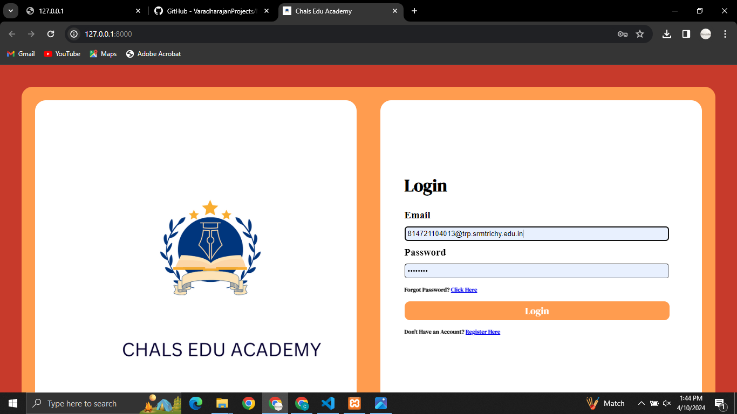
Student loginpage

Slide 12
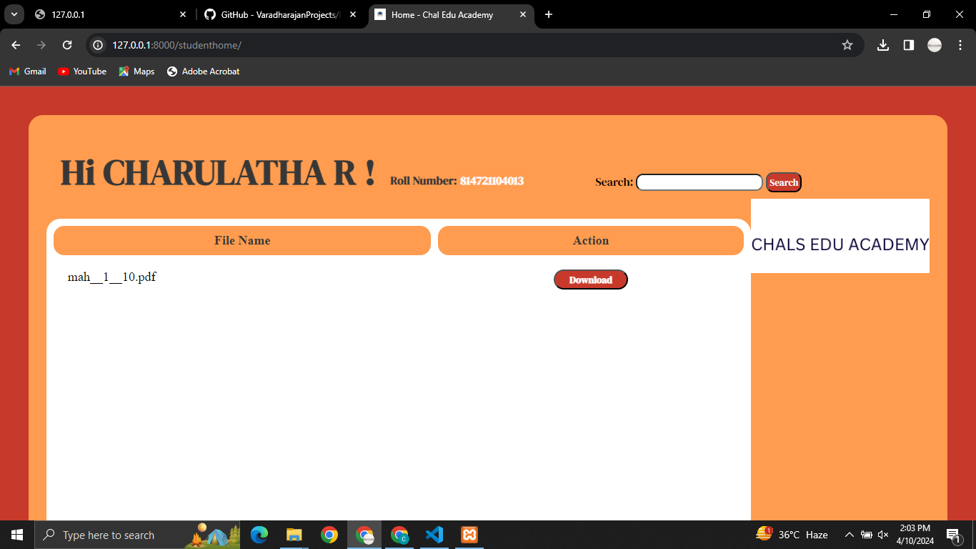
Student homepage

Slide 13
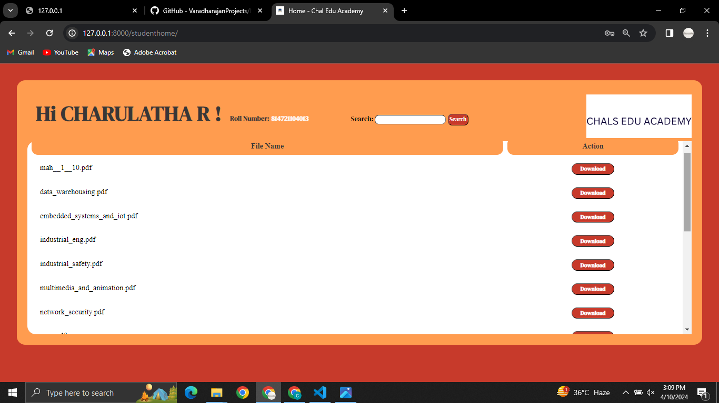
Student viewpage

Slide 14
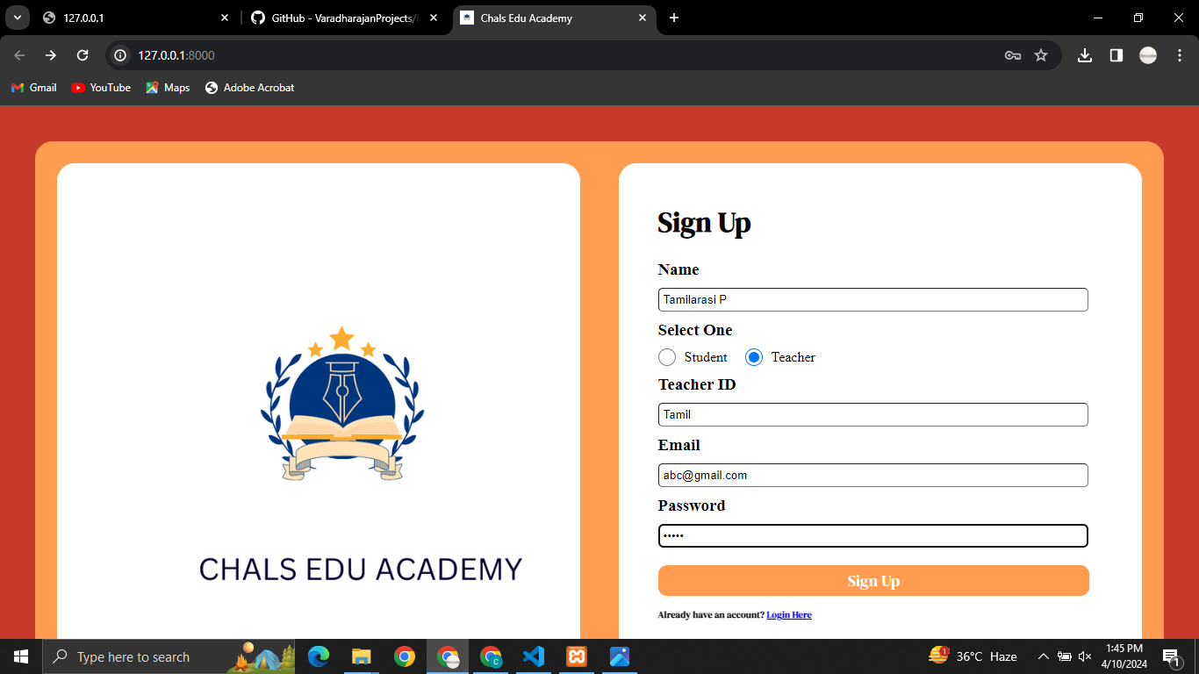
Teacher loginpage

Slide 15
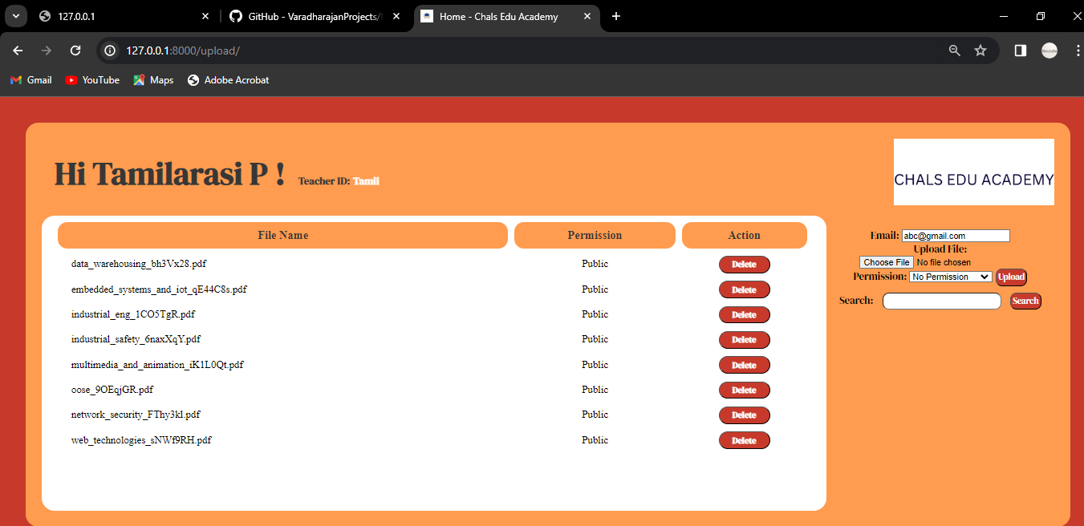
Teacher uploadpage

Slide 16
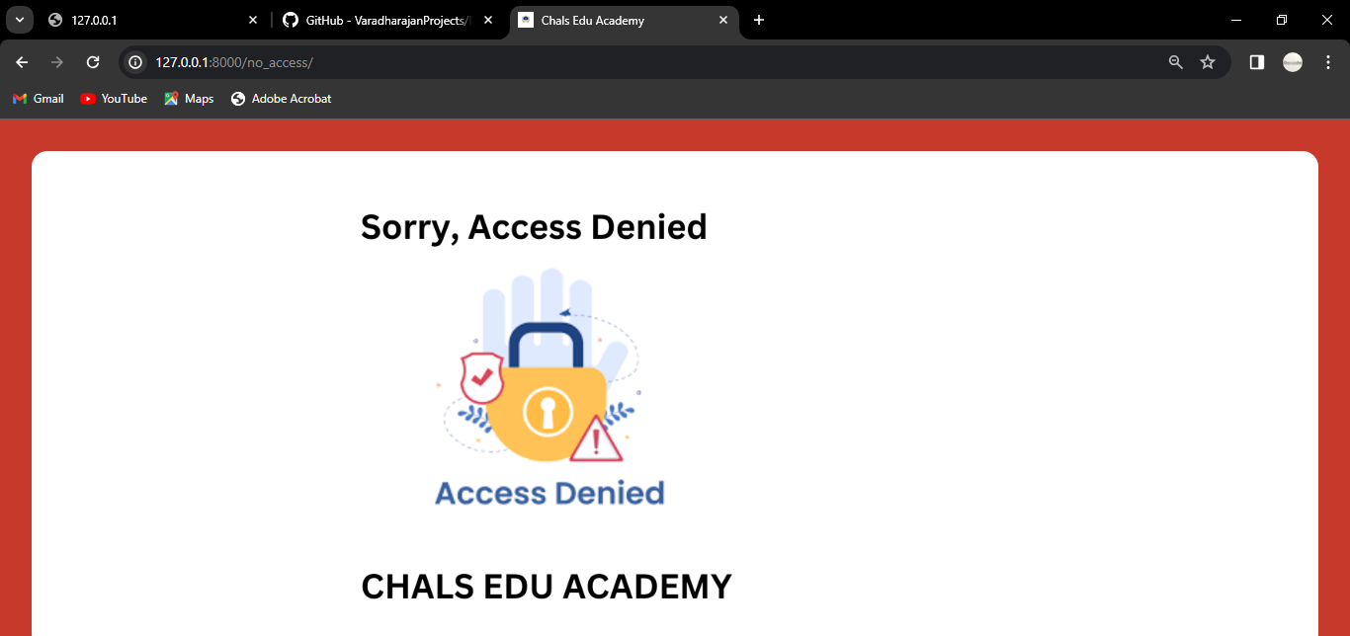
Access_Denied

Slide 17
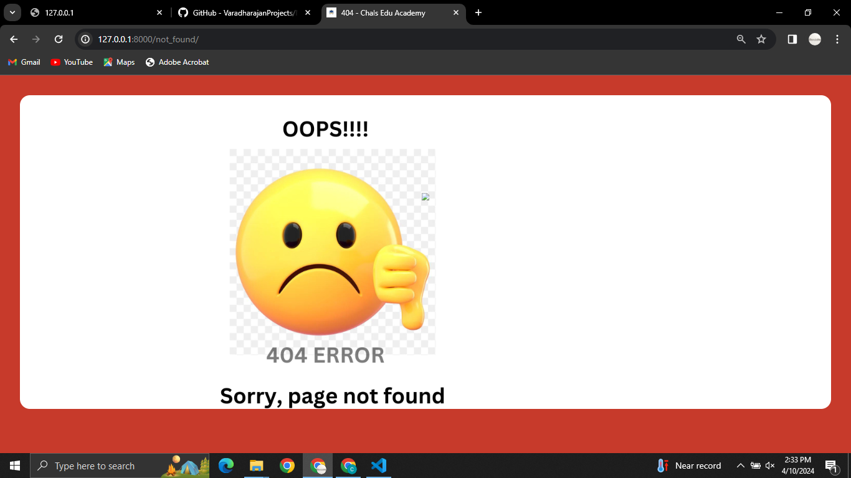
404 Error

Slide 18
Future Enhancements:
1. Collaboration:
- Add real-time chat and collaborative editing.
- Implement advanced version control like branching and merging.
2. Editing:
- Integrate WYSIWYG editor and Markdown support.
3. Integration:
- Connect with cloud storage for seamless import/export.
- Enable synchronization across devices.
4. Access:
- Introduce granular permissions and role-based access control.
5. Analytics:
- Provide insights into user engagement and note usage.
6. Mobile:
- Develop native apps for iOS and Android with synchronization.
7. Security:
- Implement two-factor authentication and regular audits.

Slide 19
Conclusion
In the realm of collaborative note-sharing, Chals Edu Academy shines as a beacon of innovation and efficiency, powered by the robust Django Framework. Its intuitive interface coupled with advanced features like real-time collaboration and granular access control, redefines the way users interact with notes. From students collaborating on projects to professionals refining strategies, Chals Edu Academy fosters seamless teamwork, driving productivity and success.
Looking ahead, the envisioned enhancements promise to elevate Chals Edu Academy to new heights of excellence. With plans to integrate cutting-edge editing tools, fortify security measures, and enhance mobile accessibility, the future is bright for this transformative platform. As a testament to the limitless possibilities of collaborative technology, Chals Edu Academy stands poised to continue revolutionizing the way we share and collaborate on notes, inspiring creativity and innovation in the process.
Source :

Slide 20
Thank You!
Notes:
Thank You !!

